Slide 1
SQL Injection
Erich Elshoff

Slide 2
Objectives
Create vulnerable web page + database
Demonstrate SQL injection attacks on vulnerable web page
Database takeover
Database manipulation - Insert / Delete / Update / Drop
Demonstrate how to defend against SQL injection attacks
Utilize 3rd party software to test for vulnerabilities

Slide 3
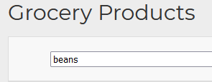


How it works
Inject SQL commands into input field
Input SQL Query

Slide 4



Types of SQL Injections
In-band - Attack and results gathered from same channel
Error Based
Union Based
Blind - Attacker cannot see results printed to attack channel
Boolean
Time Based

Slide 5


Victims
Fake grocery store with search form
Using php and MySQLi
Page 1: index.php
Page 2: multi.php

Slide 6
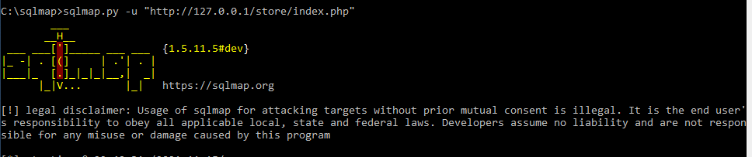
Automating the Attack
SQLMap
Automatically detects technologies / languages used
Useful penetration testing tool - finds and exploits vulnerabilities

Slide 7
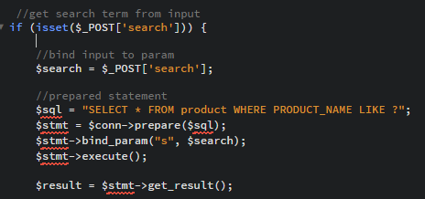
Defense
Prepared Statements
Create template of SQL query
Parse SQL template without data
Execute with user input
No way to modify query

Slide 8
Challenges
Php and MySQLi don’t allow multiple queries
Impossible to add/drop/modify tables
Solution: Second webpage using mysqli_multi_query() function
SQL injection syntax must be precise
Solution: Understand language

Slide 9
Demo

Slide 10

Questions

